Slide 1


MENTORNESS
HOTEL RESERVATION
SQL ANALYSIS
DATA ANALYST INTERN
FATIMA IRFAN KHAN MIP-DA-10

Slide 2
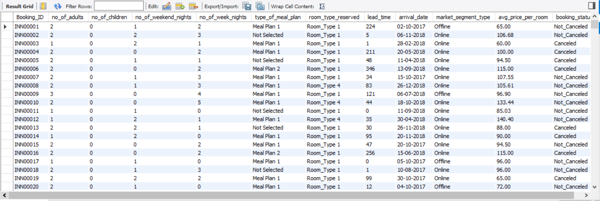

OVERVIEW
The hotel industry relies on data to make informed decisions and provide a better guest experience. In this internship, you will work with a hotel reservation dataset to gain insights into guest preferences, booking trends, and other key factors that impact the hotel's operations. You will use SQL to query and analyze the data, as well as answer specific questions about the dataset.

Slide 3

DATASET COLUMNS
01
BOOKING_ID
08
LEAD_TIME
02
NO_OF_ADULTS
09
ARRIVAL_DATE
03
NO_OF_CHILDREN
10
MARKET_SEGMENT_TYPE
04
NO_OF_WEEKEND_NIGHTS
11
AVG_PRICE_PER_ROOM
05
NO_OF_WEEK_NIGHTS
12
BOOKING_STATUS
06
TYPE_OF_MEAL_PLAN
07
ROOM_TYPE_RESERVED

Slide 4


1. WHAT IS THE TOTAL NUMBER OF RESERVATIONS IN THE DATASET?
SELECT COUNT(*) AS total_reservations
FROM hotel_reservations;

Slide 5

2. WHICH MEAL PLAN IS THE MOST POPULAR AMONG GUESTS?
SELECT type_of_meal_plan, COUNT(*) AS total_bookings
FROM hotel_reservations
GROUP BY type_of_meal_plan
ORDER BY total_bookings DESC
LIMIT 1;

Slide 6

3. WHAT IS THE AVERAGE PRICE PER ROOM FOR RESERVATIONS INVOLVING CHILDREN?
SELECT AVG(avg_price_per_room) AS avg_price_per_room_children
FROM hotel_reservations
WHERE no_of_children > 0;

Slide 7

4. HOW MANY RESERVATIONS WERE MADE FOR THE YEAR 20XX (REPLACE XX WITH THE DESIRED YEAR)?
SELECT COUNT(*) AS reservations_in_2018
FROM hotel_reservations
WHERE STR_TO_DATE(arrival_date, '%d-%m-%Y') BETWEEN '2018-01-01' AND '2018-12-31';

Slide 8

5. WHAT IS THE MOST COMMONLY BOOKED ROOM TYPE?
SELECT room_type_reserved, COUNT(*) AS total_bookings
FROM hotel_reservations
GROUP BY room_type_reserved
ORDER BY total_bookings DESC
LIMIT 1;

Slide 9
5. WHAT IS THE MOST COMMONLY BOOKED ROOM TYPE?
SELECT room_type_reserved, COUNT(*) AS total_bookings
FROM hotel_reservations
GROUP BY room_type_reserved
ORDER BY total_bookings DESC
LIMIT 1;

Slide 10

6. HOW MANY RESERVATIONS FALL ON A WEEKEND (NO_OF_WEEKEND_NIGHTS > 0)?
SELECT COUNT(*) AS weekend_reservations
FROM hotel_reservations
WHERE no_of_weekend_nights > 0;

Slide 11

7. WHAT IS THE HIGHEST AND LOWEST LEAD TIME FOR RESERVATIONS?
SELECT MAX(lead_time) AS max_reservation_time, MIN(lead_time) AS min_reservation_time
FROM hotel_reservations;

Slide 12

8. WHAT IS THE MOST COMMON MARKET SEGMENT TYPE FOR RESERVATIONS?
SELECT market_segment_type, COUNT(*) AS total_bookings
FROM hotel_reservations
GROUP BY market_segment_type
ORDER BY total_bookings DESC
LIMIT 1;

Slide 13

9. HOW MANY RESERVATIONS HAVE A BOOKING STATUS OF "CONFIRMED"?
SELECT COUNT(*) AS confirmed_reservations
FROM hotel_reservations
WHERE booking_status = 'Not_Canceled';

Slide 14
9. HOW MANY RESERVATIONS HAVE A BOOKING STATUS OF "CONFIRMED"?
SELECT COUNT(*) AS confirmed_reservations
FROM hotel_reservations
WHERE booking_status = 'Not_Canceled';

Slide 15

10. WHAT IS THE TOTAL NUMBER OF ADULTS AND CHILDREN ACROSS ALL RESERVATIONS?
SELECT SUM(no_of_adults) AS total_adults, SUM(no_of_children) AS total_children
FROM hotel_reservations;

Slide 16

11. WHAT IS THE AVERAGE NUMBER OF WEEKEND NIGHTS FOR RESERVATIONS INVOLVING CHILDREN?
SELECT AVG(no_of_weekend_nights) AS avg_weekend_nights_with_children
FROM hotel_reservations
WHERE no_of_children > 0;

Slide 17
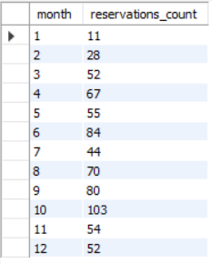
12. HOW MANY RESERVATIONS WERE MADE IN EACH MONTH OF THE YEAR?
SELECT MONTH(STR_TO_DATE(arrival_date, '%d-%m-%Y')) AS month, COUNT(*) AS reservations_count
FROM hotel_reservations
GROUP BY MONTH(STR_TO_DATE(arrival_date, '%d-%m-%Y'));

Slide 18
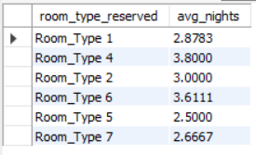
13. WHAT IS THE AVERAGE NUMBER OF NIGHTS (BOTH WEEKEND AND WEEKDAY) SPENT BY GUESTS FOR EACH ROOM type?
SELECT room_type_reserved, AVG(no_of_weekend_nights + no_of_week_nights) AS avg_nights
FROM hotel_reservations
GROUP BY room_type_reserved;

Slide 19

14. FOR RESERVATIONS INVOLVING CHILDREN, WHAT IS THE MOST COMMON ROOM TYPE, AND WHAT IS THE AVERAGE price for that room type?
SELECT room_type_reserved, COUNT(*) AS total_bookings, AVG(avg_price_per_room) AS avg_price
FROM hotel_reservations
WHERE no_of_children > 0
GROUP BY room_type_reserved
ORDER BY total_bookings DESC
LIMIT 1;

Slide 20

15. FIND THE MARKET SEGMENT TYPE THAT GENERATES THE HIGHEST AVERAGE PRICE PER ROOM.
SELECT market_segment_type, AVG(avg_price_per_room) AS avg_price_per_room
FROM hotel_reservations
GROUP BY market_segment_type
ORDER BY avg_price_per_room DESC
LIMIT 1;

Slide 21
CONCLUSION
This analysis helps provide insight into the booking trends and patterns by the hotel guests. Using SQL on MySQL, we have found some of the below insights:
Popular Meal Plan and Room Types: Meal Plan 1 and Room Type 1 are the most chosen options between guests.
Lead Time Variability: The lead time varied greatly between guests from last minute to a year in advance reservations.
Market Segment Analysis: Online market segment has highest number of reservations and also highest average room prices.
Peak season: October had the highest reservation count whereas January had the lowest.

